Slide 1
Class Diagram

Slide 2
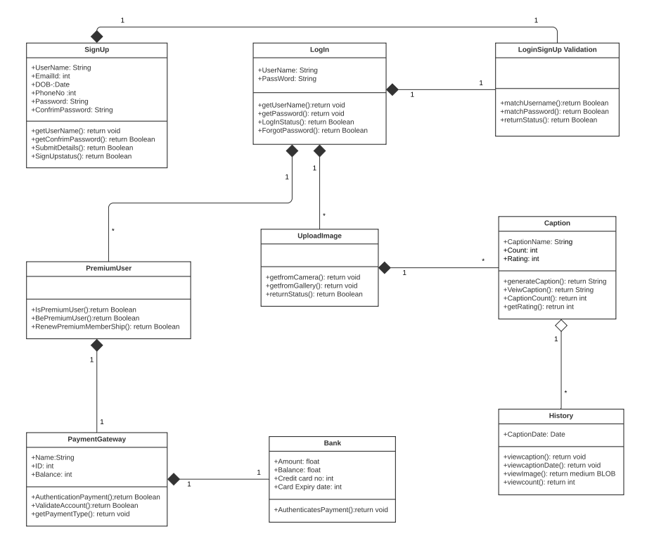

Slide 3
Sequence Diagrams

Slide 4
SEQUENCE DIAGRAM 1: LOGIN SYSTEM
SIGN UP
SIGN IN
FORGOT
PASSWORD
VERIFICATION
DATABASE
USER
Register user
valid SignUp Details
Store Details
Invalid SignUp Details
SignUp Successfully
Forgeot Password
LogIn to System
Check Security Q&A
Return
Send mail to reset password
Check Login Details
Verify login details
Verification Result
Sign In successfull
Invalid Login Details
If already
signed in
View
App Desk

Slide 5

Application
Device
User
Open application
Not signed in error
View appdesk
[Signed in]
[Choice=Enter image]
Mode
Choice
[Mode Choice=Capture image]
Choice
Access camera
Image
[Mode Choice=Choose image from storage]
Choice
Access device storage
Image
Load Image for object detectiion
Hardware failure
Warning
Scenario Diagram 2: Image load

Slide 6
SEQUENCE DIAGRAM 3: Caption Generation and Feedback
Application
Image Caption Generator
Feedback
Database
Registerd User
Open Application
Select Photo
[Access Camera/Gallery]
Load Image
Detect Objects
Retrieve
Emotions
If caption gen>20
redirect to become
Premium User
Generate
Caption
Generated Caption
Display Caption
Store the image and caption
Network Failure
Redirected to give Feedback
Store in DB
Show App Desk

Slide 7
Application
Server
User
Open application
[Signed in]
View appdesk
Choice=View History]
Choice
Access log
log
View Appdesk
Scenario Diagram 4:View History

Slide 8
SEQUENCE DIAGRAM 5: BECOME PREMIUM USER
CHOOSE TO BE PREMIUM USER
SELECT PAYMENT
Online Payment System
Credit Card Payment Gateway
Debit Card Payment Gateway
Registerd User
Select Premium User
Choose to pay
Select Payment
Option
[make payment
=Credit card]
Validate Credit Card
with banks
Notify User
Payment Success
Authorization
Success
Other success
confirmation page
Online payment
fail again select
payment option
Notify User
Payment Failure
Authorization
fail
Payment Completed
Updated User
database as premium

